Slide 1

Auth in Web Apps

Slide 2
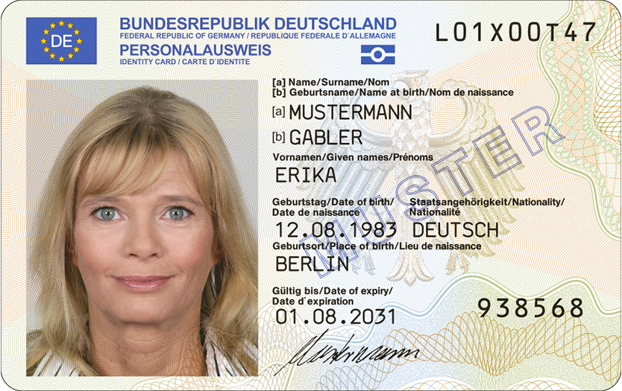
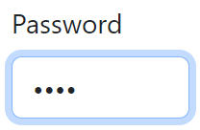

Identification vs. Authentication vs. Authorization: Knowing the differences
Identification
Authentication
Authorization
Legitimacy checks KYC procedures
Confidence, fight against fraud and money laundering
Privacy and data breach concerns
Knowledge-, Possession-, Inherence-based 1FA, MFA, SSO
Quicker process, less intrusive, cost-effective
Risk of impersonation, limited fraud detection
RBAC, ABAC, ReBAC, PBAC, Multi-party Authorization
Works in conjunction with authentication
(Ex.) The customer provides legally secure proof of their identity to the bank.
(Ex.) The bank verifies that an individual accessing its services is still the same legitimate account holder.
(Ex.) The bank determines what services and resources a verified customer is permitted to access.
https://commons.wikimedia.org/wiki/File:Deutscher_Personalausweis_(2021_Version).jpg
https://oauth.net/images/oauth-logo-square.png

Slide 3

Part 1: Authentication

Slide 4
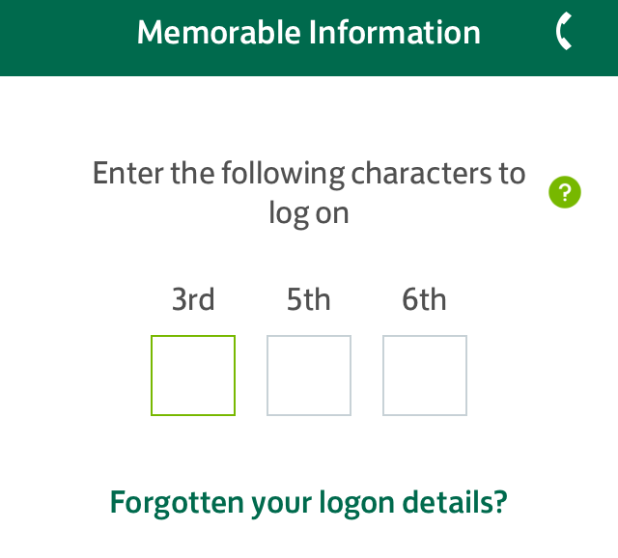
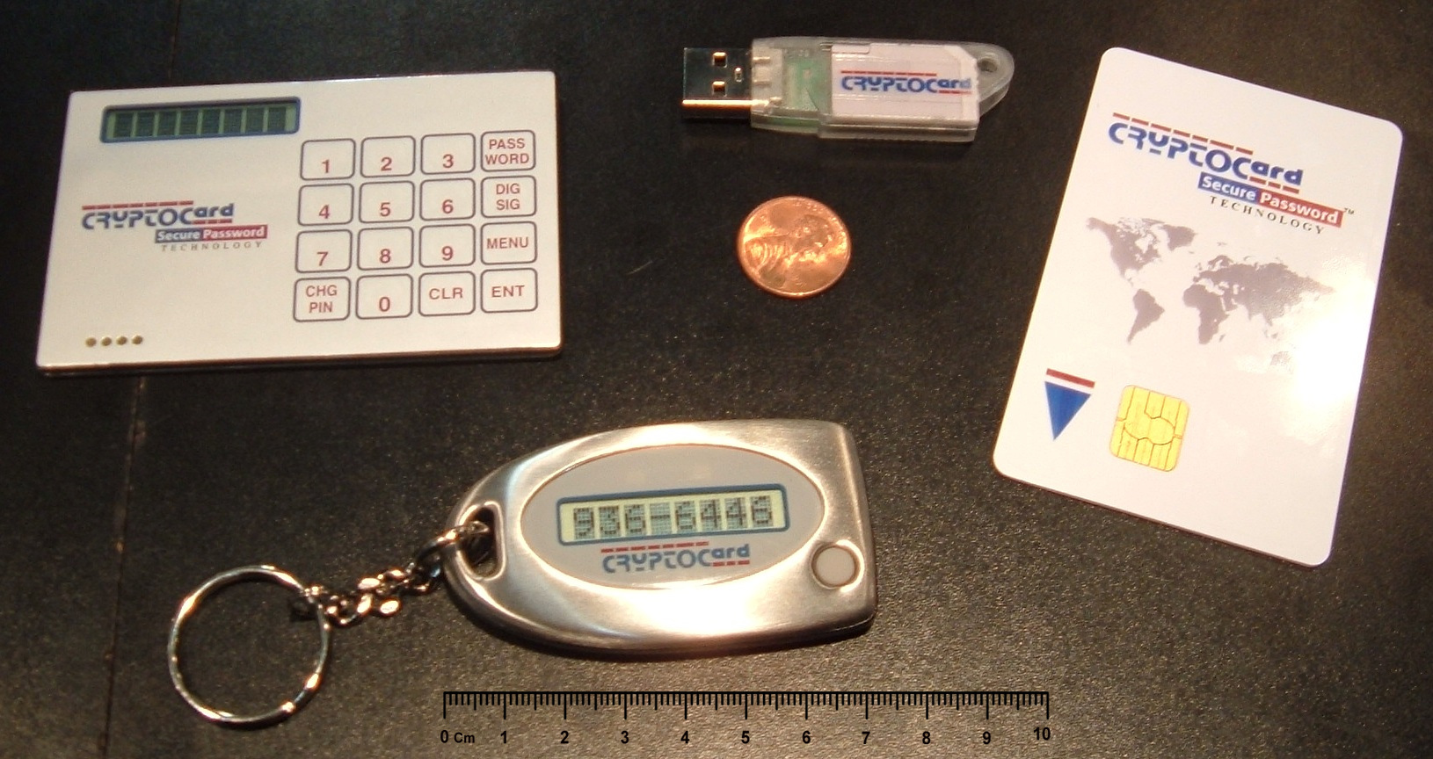
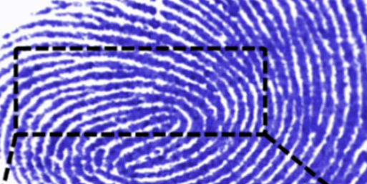
A practical overview of authentication methods
Knowledge (Secret)
Possession (Ownership)
Inherence (Biometric)
Challenge Response (CRAM)
OTP
Partial Password
Passphrase
Password
Pattern
Personally Identifiable Information (PII)
PIN
Security Question
ID card
Implant
Smartcard
Smartphone
App
Phone Call
SMS
Smartwatch
Security Token
NFC
Software
USB
Wrist band
Brain waves
Breath
DNA sequence
Face
Fingerprint / Handprint
Gait (movement)
Iris / Retina
Keystroke dynamics
Signature
Voice
https://en.wikipedia.org/wiki/File:Partial_password_entry_form.png
https://commons.wikimedia.org/wiki/File:SecurityTokens.CryptoCard.agr.jpg
https://commons.wikimedia.org/wiki/File:Teerahertz_near-field_array_for_%CE%BCm-scale_surface_imaging_(cropped).png

Slide 5
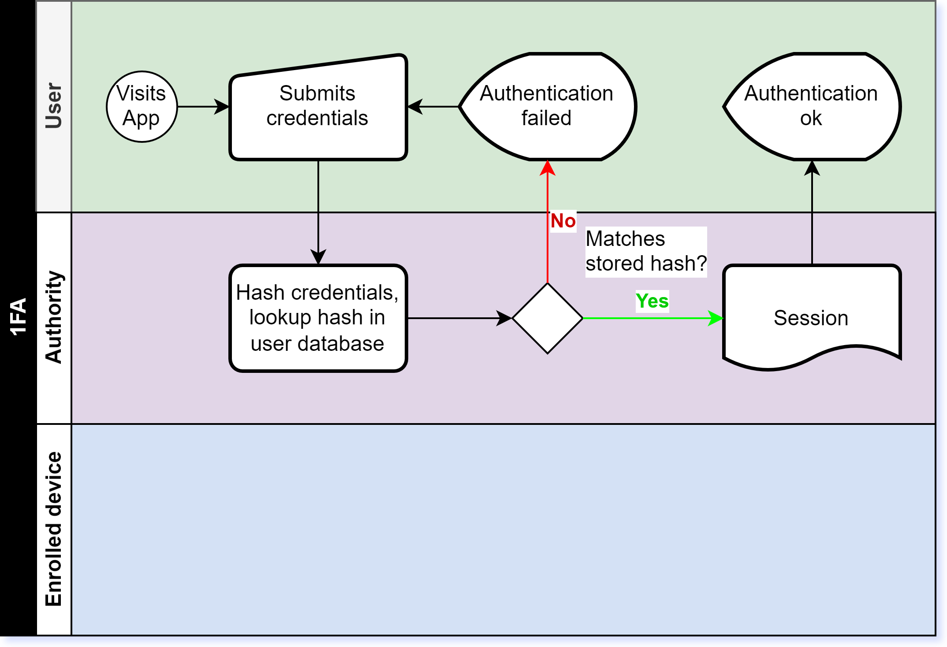
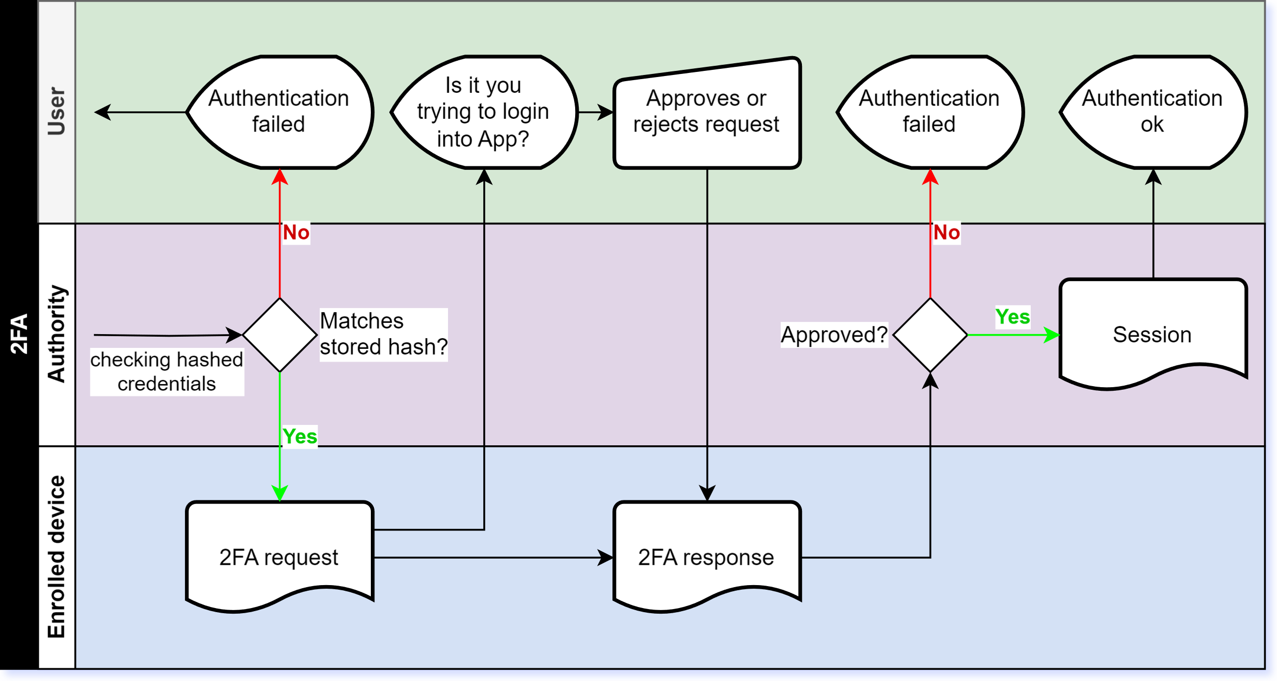
1FA vs MFA: Mitigating phishing attacks.
1FA Asks for only one factor to verify identity claim.
MFA Requires authentication on additional factors

Slide 6
Keep your secrets secret.
Store hash of a password, seasoned with random salt, to prevent dictionary attacks.
Protect keystores and certificates using symmetric-key encryption.
Encrypt secrets with public-key cryptography in a client before transfer.
Transport-layer encryption leaks secrets to SSL/TLS termination proxies.
Authorized receivers can read the secret when they know the private key.

Slide 7

Part 2: Authorization

Slide 8
Permitting access: From role-models to
Early methods: Simple user roles and hard-coded permissions.
Development of role-based access control (RBAC).
Modern approaches: Attribute-based access control (ABAC) and policy-based access control (PBAC).
RBAC, ABAC, ReBAC, PBAC, Multi-party Authorization

Slide 9
Modelling authorization in a bank

Slide 10

Part 3: Delegated authorization

Slide 11
Get Introduced to OAuth 2.0 and Its Components
Introduction to OAuth 2.0: What It Is and How It Works
OAuth 2.0 overview: Authorization framework, not an authentication protocol.
Key components: Resource owner, client, resource server, and authorization server.
How OAuth 2.0 improves security and user experience.

Slide 12
Learn How to Implement OAuth 2.0 in Web Applications
Implementing OAuth 2.0: Steps and Considerations
Different grant types: Authorization code, implicit, password, and client credentials.
Securing OAuth 2.0 tokens and handling token expiration.
Real-world examples and best practices for implementation.

Slide 13
Conclude with Key Takeaways on OAuth 2.0 and Security
Key Takeaways and Future Considerations for Web Security
Summary of the benefits of using OAuth 2.0.
Future trends in authentication and authorization.
Encouraging continuous learning and adaptation to new security threats.

